Slide 1
Module - II
BCAN - 401

Slide 2
Difference between DBMS and File System -
DBMS | File System
DBMS is a collection of data. In DBMS, the user is not required to write the procedures. | File system is a collection of data. In this system, the user has to write the procedures for managing the database.
DBMS gives an abstract view of data that hides the details. | File system provides the detail of the data representation and storage of data.
DBMS provides a crash recovery mechanism, i.e., DBMS protects the user from the system failure. | File system doesn't have a crash mechanism, i.e., if the system crashes while entering some data, then the content of the file will lost.
DBMS provides a good protection mechanism. | It is very difficult to protect a file under the file system.
DBMS contains a wide variety of sophisticated techniques to store and retrieve the data. | File system can't efficiently store and retrieve the data.
DBMS takes care of Concurrent access of data using some form of locking. | In the File system, concurrent access has many problems like redirecting the file while other deleting some information or updating some information.

Slide 3
Difference between DBMS and RDBMS -
DBMS | RDBMS
DBMS applications store data as file. | RDBMS applications store data in a tabular form.
In DBMS, data is generally stored in either a hierarchical form or a navigational form. | In RDBMS, the tables have an identifier called primary key and the data values are stored in the form of tables.
Normalization is not present in DBMS. | Normalization is present in RDBMS.
DBMS does not apply any security with regards to data manipulation. | RDBMS defines the integrity constraint for the purpose of ACID (Atomocity, Consistency, Isolation and Durability) property.
DBMS uses file system to store data, so there will be no relation between the tables. | in RDBMS, data values are stored in the form of tables, so a relationship between these data values will be stored in the form of a table as well.
DBMS has to provide some uniform methods to access the stored information. | RDBMS system supports a tabular structure of the data and a relationship between them to access the stored information.
DBMS does not support distributed database. | RDBMS supports distributed database.
DBMS is meant to be for small organization and deal with small data. it supports single user. | RDBMS is designed to handle large amount of data. it supports multiple users.
Examples of DBMS are file systems, xml etc. | Example of RDBMS are mysql, postgre, sql server, oracle etc.

Slide 4
What is RDBMS?
RDBMS stands for Relational Database Management System.
All modern database management systems like MS SQL Server, IBM DB2, ORACLE, My-SQL and Microsoft Access are based on RDBMS.
It is called Relational Data Base Management System (RDBMS) because it is based on relational model introduced by E.F. Codd.
Data is represented in terms of tuples (rows) in RDBMS.
Relational database is most commonly used database. It contains number of tables and each table has its own primary key.
Due to a collection of organized set of tables, data can be accessed easily in RDBMS.
During 1970 to 1972, E.F. Codd published a paper to propose the use of relational database model.
RDBMS is originally based on that E.F. Codd's relational model invention.

Slide 5
What is Table?
The RDBMS database uses tables to store data.
A table is a collection of related data entries and contains rows and columns to store data.
ID | Name | AGE | COURSE
1 | Ajeet | 24 | B.Tech
2 | aryan | 20 | C.A
3 | Mahesh | 21 | BCA
4 | Ratan | 22 | MCA
5 | Vimal | 26 | BSC

Slide 6
What is Field?
Field is a smaller entity of the table which contains specific information about every record in the table.
What is row or record?
A row of a table is also called record. It contains the specific information of each individual entry in the table. It is a horizontal entity in the table.
What is column?
A column is a vertical entity in the table which contains all information associated with a specific field in a table. For example: "name" is a column in the above table which contains all information about student's name.
1 | Ajeet | 24 | B.Tech
Ajeet
Aryan
Mahesh

Slide 7
What is NULL Values?
The NULL value of the table specifies that the field has been left blank during record creation. It is totally different from the value filled with zero or a field that contains space.
What do you mean by Data Integrity?
There are the following categories of data integrity exist with each RDBMS:
Entity integrity: It specifies that there should be no duplicate rows in a table.
Domain integrity: It enforces valid entries for a given column by restricting the type, the format, or the range of values.
Referential integrity: It specifies that rows cannot be deleted, which are used by other records.
User-defined integrity: It enforces some specific business rules that are defined by users. These rules are different from entity, domain or referential integrity.

Slide 8
Some Definitions –
Instance – Current content of the database. (Collection of information stored in database as a particular moment).
Schema – Overall design of the database.
Data Independence –
Data independence can be explained using the three-schema architecture.
Data independence refers characteristic of being able to modify the schema at one level of the database system without altering the schema at the next higher level.
Logical Data Independence –
Logical data independence refers characteristic of being able to change the conceptual schema without having to change the external schema.
Logical data independence is used to separate the external level from the conceptual view.
If we do any changes in the conceptual view of the data, then the user view of the data would not be affected.
Logical data independence occurs at the user interface level.

Slide 9
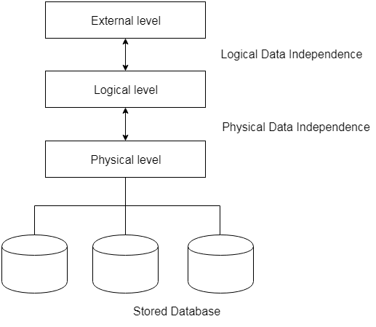
Physical Data Independence –
Physical data independence can be defined as the capacity to change the internal schema without having to change the conceptual schema.
If we do any changes in the storage size of the database system server, then the Conceptual structure of the database will not be affected.
Physical data independence is used to separate conceptual levels from the internal levels.
Physical data independence occurs at the logical interface level.

Slide 10
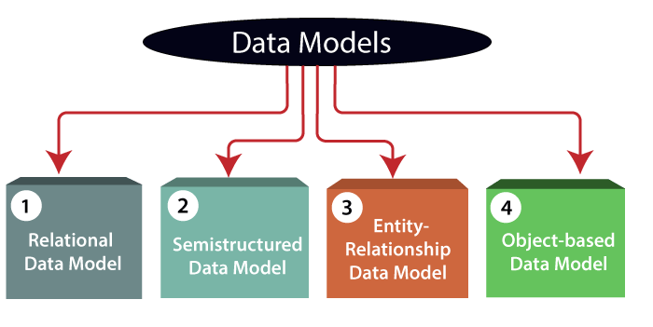
Data Models - Data Model is the modeling of the data description, data semantics, and consistency constraints of the data. It provides the conceptual tools for describing the design of a database at each level of data abstraction. Therefore, there are following four data models used for understanding the structure of the database:

Slide 11
Relational Data Model - This type of model designs the data in the form of rows and columns within a table. Thus, a relational model uses tables for representing data and in-between relationships. Tables are also called relations. This model was initially described by Edgar F. Codd, in 1969. The relational data model is the widely used model which is primarily used by commercial data processing applications.
Entity-Relationship Data Model - An ER model is the logical representation of data as objects and relationships among them. These objects are known as entities, and relationship is an association among these entities. This model was designed by Peter Chen and published in 1976 papers. It was widely used in database designing. A set of attributes describe the entities. For example, student_name, student_id describes the 'student' entity. A set of the same type of entities is known as an 'Entity set', and the set of the same type of relationships is known as 'relationship set'.
Object-based Data Model - An extension of the ER model with notions of functions, encapsulation, and object identity, as well. This model supports a rich type system that includes structured and collection types. Thus, in 1980s, various database systems following the object-oriented approach were developed. Here, the objects are nothing but the data carrying its properties.

Slide 12
Semi structured Data Model - This type of data model is different from the other three data models (explained above). The semi structured data model allows the data specifications at places where the individual data items of the same type may have different attributes sets. The Extensible Markup Language, also known as XML, is widely used for representing the semi structured data. Although XML was initially designed for including the markup information to the text document, it gains importance because of its application in the exchange of data.

Slide 13
Some Definitions –
Data Isolation – A database system is entirely different than its data. A database is an active entity, whereas data is said to be passive, on which the database works and organizes. DBMS also stores metadata, which is data about data, to easy its own process.
Less Redundancy – DBMS follows the rules of normalization, which splits a relation when any of its attributes, is having redundant in values. Normalization is a mathematically rich and scientific process that reduces data redundancy.
Data Consistency – Consistency is a state where every relation in a database remains consistent. There exists methods and techniques, which can detect the attempt of leaving database in inconsistent state. A DBMS can provide greater consistency as compared to earlier forms of data storing application like file processing system.
ACID Properties – DBMS follows the concepts of Atomicity, Consistency, Isolation & Durability. These concepts are applied on transactions, which manipulate data in a database. ACID properties help the database stay healthy in multi-transactional environments.
Atomicity - The term atomicity defines that the data remains atomic. It means if any operation is performed on the data, either it should be performed or executed completely or should not be executed at all. It further means that the operation should not break in between or execute partially.

Slide 14
Some Definitions –
Consistency - The word consistency means that the value should remain preserved always. In DBMS, the integrity of the data should be maintained, which means if a change in the database is made, it should remain preserved always. In the case of transactions, the integrity of the data is very essential so that the database remains consistent before and after the transaction. The data should always be correct.
Isolation - The term 'isolation' means separation. In DBMS, Isolation is the property of a database where no data should affect the other one and may occur concurrently. In short, the operation on one database should begin when the operation on the first database gets complete. It means if two operations are being performed on two different databases, they may not affect the value of one another.
Durability - Durability ensures the permanency of something. In DBMS, the term durability ensures that the data after the successful execution of the operation becomes permanent in the database. The durability of the data should be so perfect that even if the system fails or leads to a crash, the database still survives. However, if gets lost, it becomes the responsibility of the recovery manager for ensuring the durability of the database. For committing the values, the COMMIT command must be used every time we make changes.
Therefore, the ACID property of DBMS plays a vital role in maintaining the consistency and availability of data in the database.

Slide 15
Relational Model –
Relational model can represent as a table with columns and rows. Each row is known as a tuple. Each table of the column has a name or attribute.
Domain: It contains a set of atomic values that an attribute can take.
Attribute: It contains the name of a column in a particular table. Each attribute Ai must have a domain, dom(A_{i})
Relational instance: In the relational database system, the relational instance is represented by a finite set of tuples. Relation instances do not have duplicate tuples.
Relational schema: A relational schema contains the name of the relation and name of all columns or attributes.
Relational key: In the relational key, each row has one or more attributes. It can identify the row in the relation uniquely.
NAME | ROLL_NO | PHONE_NO | ADDRESS | AGE
Ram | 14795 | 7305758992 | Noida | 24
Shyam | 12839 | 9026288936 | Delhi | 35
Laxman | 33289 | 8583287182 | Gurugram | 20
Mahesh | 27857 | 7086819134 | Ghaziabad | 27
Ganesh | 17282 | 9028 9i3988 | Delhi | 40
In the given table, NAME, ROLL_NO, PHONE_NO, ADDRESS, and AGE are the attributes.
The instance of schema STUDENT has 5 tuples.
t3 = <Laxman, 33289, 8583287182, Gurugram, 20>

Slide 16
Properties of Relations –
Name of the relation is distinct from all other relations.
Each relation cell contains exactly one atomic (single) value
Each attribute contains a distinct name
Attribute domain has no significance
Tuple has no duplicate value
Order of tuple can have a different sequence

